Slide 1

Lecture 9: Parallel Performance Tools Future
Allen D. Malony
Department of Computer and Information Science

Slide 2
Perspective – Parallel Tools Experience
Performance has been the fundamental driving concern for parallel computing high-performance computing
Performance observation, modeling, and engineering are key methodologies to deliver the potential of parallel, HPC machines
However, there has always been a strained relationship between performance tools and the parallel computing
Performance considered necessary, but an afterthought
There are compelling reasons for performance methods and technologies to be integrated throughout parallel computing
To obtain, learn, and carry forward performance knowledge
To address increasing scalability and complexity issues
To bridge between programming semantics (computation model) and execution model operation

Slide 3
Parallel Performance Engineering
Scalable, optimized applications deliver HPC promise
Optimization through performance engineering process
Understand performance complexity and inefficiencies
Tune application to run optimally on high-end machines
How to make the process more effective and productive?
What is the nature of the performance problem solving?
What is the performance technology to be applied?
Performance tool efforts have been focused on performance observation, analysis, problem diagnosis
Application development and optimization productivity
Programmability, reusability, portability, robustness
Performance technology part of larger programming system
Parallel systems evolution will change process, technology, and use of tools

Slide 4
Retrospective (1991) – Performance Observability
Performance evaluation problems define the requirements for performance measurement and analysis methods
Performance observability is the ability to “accurately” capture, analyze, and present understand (collectively observe) information about parallel software and system
Tools for performance observability must balance the need for performance data against the cost of obtaining it (environment complexity, performance intrusion)
Too little performance data makes analysis difficult
Too much data perturbs the measured system
Important to understand performance observability complexity and develop technology to address it

Slide 5
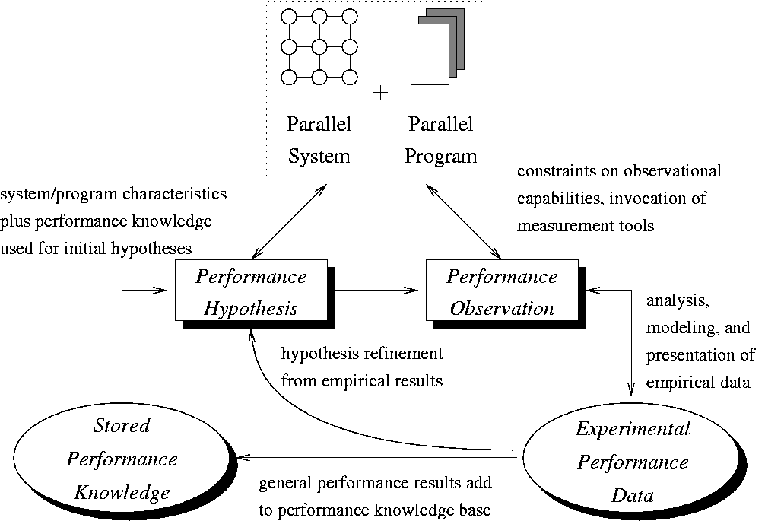

Retrospective (1998-2007) – Performance Diagnosis
Performance diagnosis is a process to detect and explain performance problems

Slide 6
Performance Diagnosis Projects
APART – Automatic Performance Analysis - Real Tools
Problem specification and identification
Poirot – theory of performance diagnosis processes
Compare and analyze performance diagnosis systems
Use theory to create system that is automated / adaptable
Heuristic classification: match to characteristics
Heuristic search: look up solutions with problem knowledge
Problems: low-level feedback, lack of explanation power
Hercule – knowledge-based (model-based) diagnosis
Capture knowledge about performance problems
Capture knowledge about how to detect and explain them
Knowledge comes from parallel computational models
associate computational models with performance models

Slide 7
Retrospective (2008-2012) – Performance Complexity
Performance tools have evolved incrementally to serve the dominant architectures and programming models
Reasonably stable, static parallel execution models
Allowed application-level observation focus
Observation by first person measurement model:
Performance measurement can be made locally (per thread)
Performance data collected at the end of the execution
Post-mortem analysis and presentation of performance results
Offline performance engineering
Increasing performance complexity
Factors: core counts, hierarchical memory architecture, interconnection technology, heterogeneity, and scale
Focus on performance technology integration

Slide 8
Evolution
Increased performance complexity and scale forces the engineering process to be more intelligent and automated
Automate performance data analysis / mining / learning
Automated performance problem identification
Even with intelligent and application-specific tools, the decisions of what to analyze are difficult
Performance engineering tools and practice must incorporate a performance knowledge discovery process
Model-oriented knowledge
Computational semantics of the application
Symbolic models for algorithms
Performance models for system architectures / components
Application developers can be more directly involved in the performance engineering process

Slide 9
Need for Whole Performance Evaluation
Extreme scale performance is an optimized orchestration
Application, processor, memory, network, I/O
Reductionist approaches to performance will be unable to support optimization and productivity objectives
Application-level only performance view is myopic
Interplay of hardware, software, and system components
Ultimately determines how performance is delivered
Performance should be evaluated in toto
Application and system components
Understand effects of performance interactions
Identify opportunities for optimization across levels
Need whole performance evaluation practice

Slide 10
“Extreme” Performance Engineering
Empirical performance data evaluated with respect to performance expectations at levels of abstraction

Slide 11
Revolution (for Exascale)
First person measurement (post-mortem analysis) not viable
Highly concurrent and dynamic execution model
post-mortem analysis of low-level data prohibitive
Interactions with scarce and shared resources
introduces bottlenecks and queues on chip/node and between nodes
Multiple objectives (performance, energy, resilience, …)
Dynamic variability motivates need for runtime adaptation
Third person measurement model required (in addition)
Focus is on system activity characterization at different levels
system resource usage is a primary concern
Measurements are analyzed relative to contributors
Online analysis and availability of performance allows introspective adaptation for objective evaluation and tuning

Slide 12
A New “Performance” Observability
Exascale requires a fundamentally different “performance” observability paradigm
Designed specifically to support introspective adaptation
Reflects computation model mapped to execution model
Aware of multiple objectives (“performance”)
In-situ analysis of performance state and objectives
Key parallel “performance” abstraction
Inherent state of exascale execution is dynamic
Embodies non-stationarity of “performance”
Constantly shaped by the adaptation of resources to meet computational needs and optimize execution objectives

Slide 13
Needs Integration in Exascale Software Stack
Exascale programming methodology can include observability awareness and adaptability
Programming system exposes alternatives
parameters, algorithms, parallelism control, …
Runtime state awareness can be coupled with application knowledge for self-adaptive, closed-loop runtime tuning
richer contextualization and attribution of performance state
Enables top-down application transformations to be optimized for runtime and system layers
Feeding back dynamic information about HW/SW software resources from bottom-up
Performance introspection and dynamic adaptivity
Requires support in OS and runtime environment

Slide 14
Willing Suspension of (Observability) Disbelief
Suppose that full knowledge of the state of the exascale system were available
Can observe it at any time
No cost to produce it, access it, or analyze it
No cost to provide it to wherever it might be used
How/where could it be used in an exascale system?
Would it fundamentally change how an exascale system is programmed?
How would you incorporate such a capability in the exascale software stack?

Slide 15
XPRESS Project (DOE X-Stack)
Design and development of exascale software stack to support the ParalleX execution model
Highly concurrent
Asynchonous
Message driven
Global address space
OpenX
XPI programming API
HPX runtime system
RIOS interface to OS
APEX performance system
Team
Universities: IU, LSU, UH, UNC/RENCI, UO
Laboratories: SNL, LBNL, ORNL

Slide 16
Integrated Software Stack for ParalleX
OpenX
XPI programming API
HPX runtime system
RIOS interface to OS
APEX performance system
APEX
OS (LXK) tracks system- level resources
Runtime (HPX) tracks threads, queues, parcels, remote ops, memory, concurrency
XPI allows, allow language-level performance semantics to be measured

Slide 17
APEX Prototype Approach
APEX
TAU
Resource client
Shared performance space
DSL or
Legacy
State
XPI
State
HPX
State
OS
State
HW State
APEX:
- monitors performance state
- “broadcasts” performance state
- “triggers” an action
RCRtoolkit
Systems Resource Monitor

Slide 18
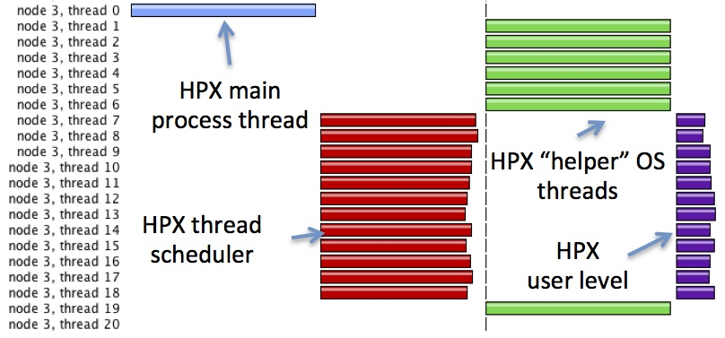
APEX Prototyping with HPX-3 and TAU

Slide 19
Argo DOE ExaOSR Project
Exascale OS and runtime research project
Team
Labs: ANL, LLNL, PNL
Universities: BU, UC, UIUC, UO, UTK
Philosophy
Whole-system view
dynamic user environment (functionality, dynamism, flexibility)
first-class managed resources (performance, power, …)
hierarchical response to faults
Massive concurrency support
Key ideas relevant to ESPT
Hierarchical (control, communication, goals, data resolution)
Embedded (performance, power, …) feedback and response
Global system support

Slide 20
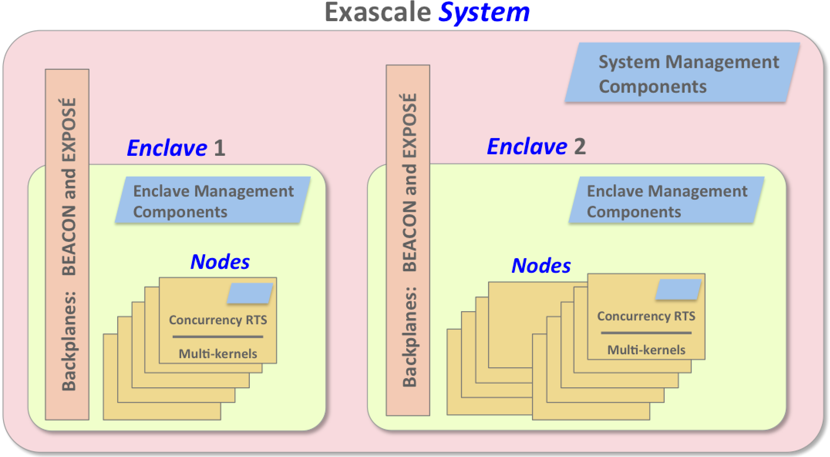
Argo Exascale System View
Node OSR
Lightweight runtime for concurrency
Event, control, and performance backplane
Global optimization / global view

Slide 21
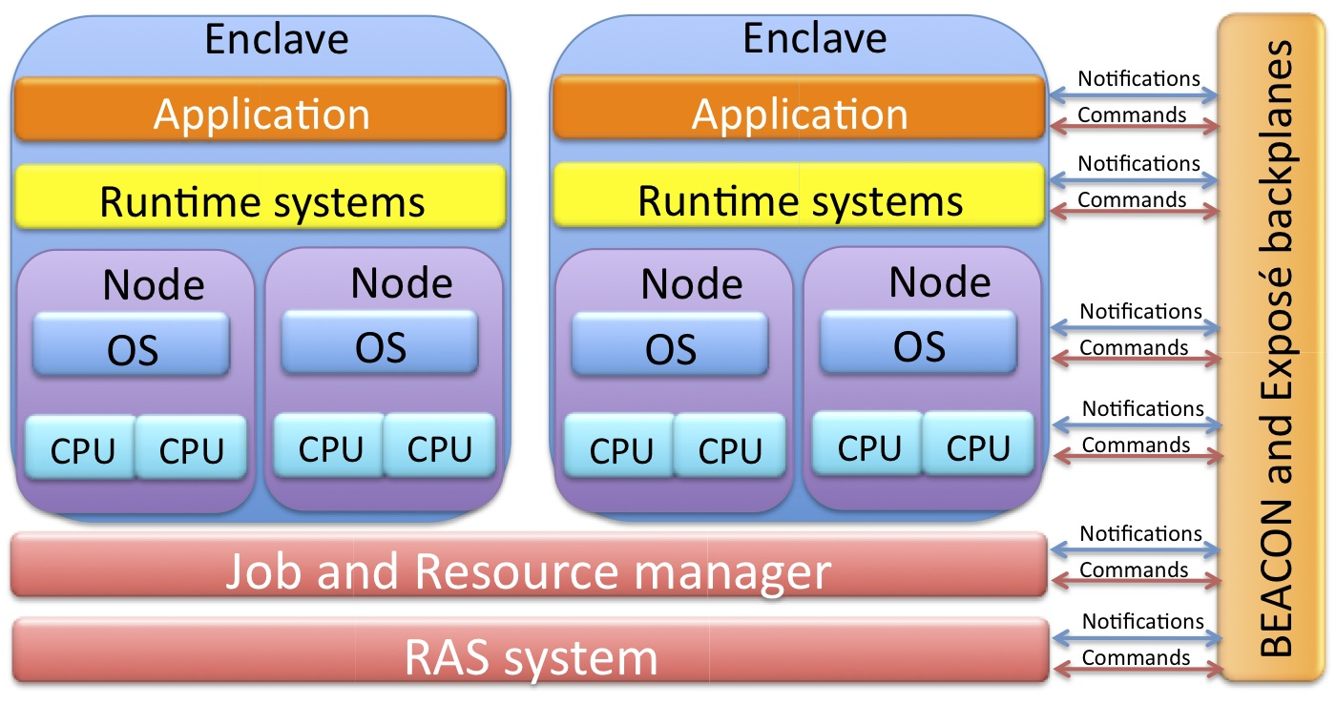
Argo Global Information Backplane
BEACON: event/action/control notification
Exposé: performance observability system

Slide 22
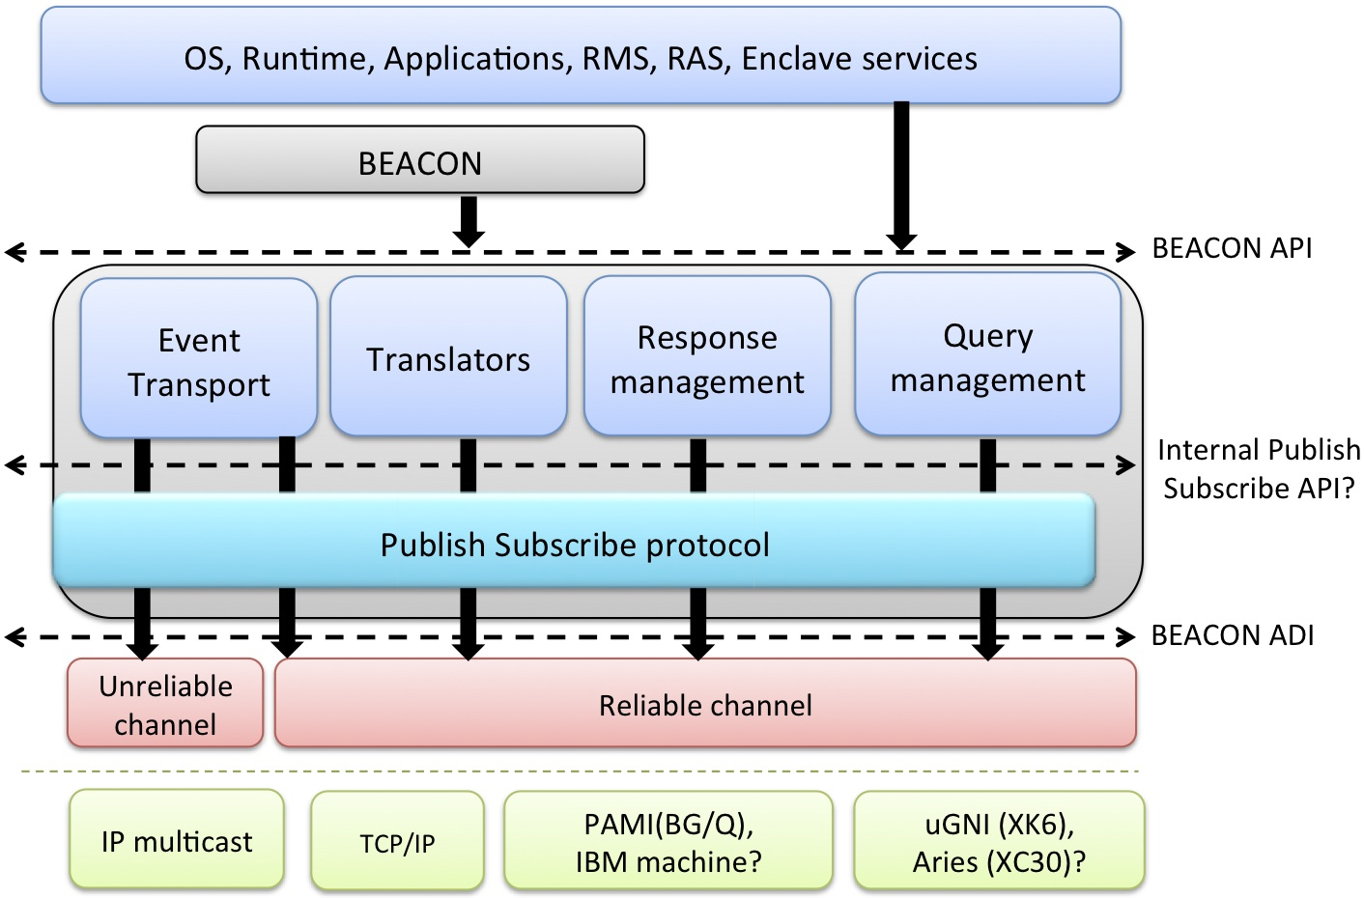
BEACON Architecture
Notes:
Research challenges
High-performance, scalable, resilient architecture
Hierarchical, cross-layer, responsive signaling
Cross-layer publish/subscribe environment
Targeting Argo backplane for expected systems characteristics at extreme scale
Design
Design and prototype the backplane API based on scalable, hierarchical publish-subscribe model
Define API according to system software/application needs notification signaling and listening
Design message delivery for reliability requirements appropriate to criticality of different events

Slide 23
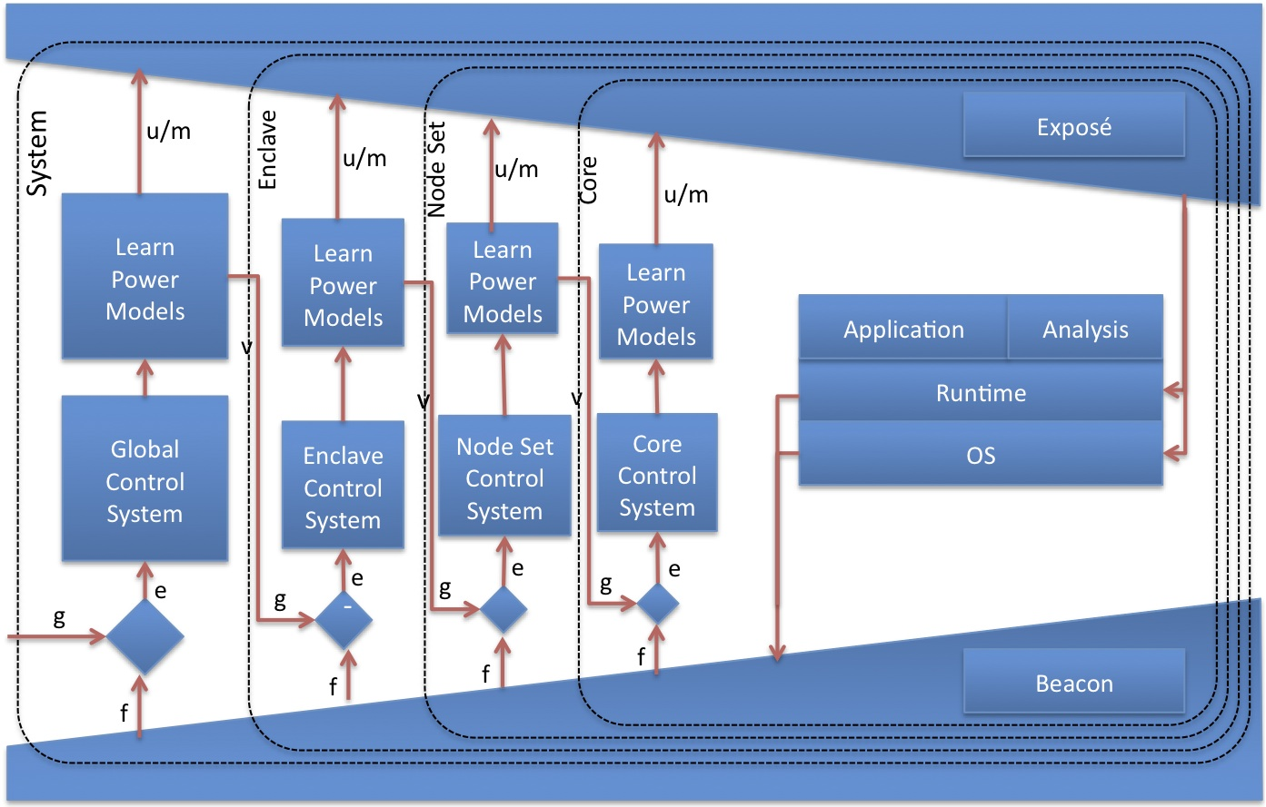
Global Optimization View
g – power, performance goals
f – feedback from BEACON and EXPOSÉ
e – error between goals and feedback
u – generalized control signals
v – settings for next level
m – power/resilience models & mechanisms

Slide 24
Research Projects
PRIMA-X (DOE ASCR, UO, Research Centre Juelich, Aachen)
Refactoring core performance measurement infrastructure
Vancouver (DOE X-Stack, ORNL, UO, GT, UIUC) (in renewal)
Heterogeneous performance measurement (with GPUs)
SUPER (DOE SciDAC Institute, many partners)
Performance tools integration for end-to-end analysis, autotuning, energy, and resilience
GlassBox (NSF OCI SI² program, GT, UH, UO)
Open interactions in HPC toolchain (compiler, runtime, I/O)
Integrated performance observation and knowledge sharing
XPRESS (DOE X-Stack, SNL, IU, UNC, UH, UO, LSU)
Integrated software ecosystem for ParalleX
Online, adaptive optimization and control
Argo (DOE ExaOSR, ANL, PNNL, LLNL, UO, UC, UIUC)
OS and runtime technology for exascale
Scalable signaling, introspection, feedback
E (R)
E
E
E (R)
R
R
Evolution
Revolution

Slide 25
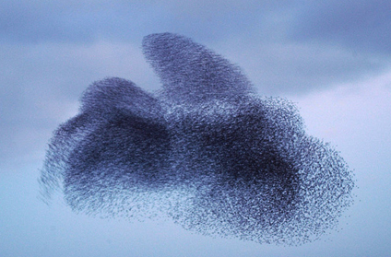
Performance as Collective Behavior
New performance observability paradigm can be thought of as providing collective awareness for exascale
It allows the exascale system to be performance-aware and performance-reactive, able to observe performance state wholistically and holistically and to couple it with application knowledge for self-adaptive, runtime control
Exascale systems might be considered to then be functioning as an self-organizing performance collective whose behavior is a natural consequence of seeking highly efficient operational forms optimizing exascale objectives

